Slide 1
Battle of the Neighborhoods: Mediterranean Restaurants in New York City
IBM- Applied Data Science Capstone
Coursera.org
Neshat J Heravi
December 2020

Slide 2

Problem Statement
The objective of this project is to apply Data Science methodology and techniques to solve the problem at hand; Where is the best location to open a brand-new Mediterranean restaurant in New York City? And which restaurant has the best rating as of now?

Slide 3
data
Data Required
New York City’s boroughs and neighborhoods
Latitude and longitude location of each neighborhood
Detail information for the Mediterranean restaurants; such as number of likes and ratings
Data Source
New York City’s location data from open source: http://cocl.us/new_york_dataset
Getting the latitude and longitude data using Geocoder libraryhttp://cocl.us/new_york_dataset t from Python
Getting the restaurant data from Foursquare API
Using Folium library in Python to create maps

Slide 4
Methodology
Got the data from the open source (http://cocl.us/new_york_dataset) and processed it into dataframe
Used the Geocoder package to access the latitude and longitude of each neighborhood
Extracted the Mediterranean data from Foursquare API
Converted the data type from ‘object’ to ‘float64’ to be able to apply statistical analysis
Sorted the Mediterranean restaurants based on number of likes and the ratings
Got the average rating of the Mediterranean restaurants in each neighborhood
Used visualization techniques to assist the data analysis

Slide 5

Results
Total of 39 Mediterranean restaurants (in New York City) data are available in Foursquare’s database
There are 32 unique Mediterranean restaurants and 7 chain restaurants.
Manhattan has the highest number of Mediterranean restaurants (27 restaurants)
Soho and Flatiron have the highest number of Mediterranean restaurants among other neighborhoods (4 in each)

Slide 6
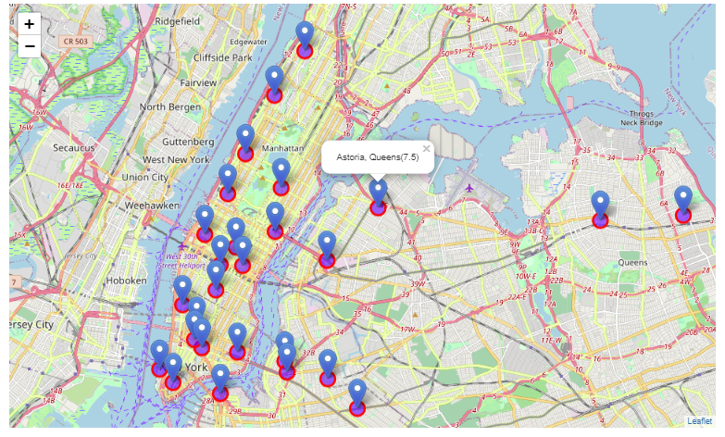
Results
Manhattan with the average rating of 8.53 for the Mediterranean restaurants has the highest rating among boroughs.
The results show that West Village has the highest average rating among the Mediterranean restaurant (average rating of 9.30)
The ‘Jack's Wife Freda’ located in Soho (Manhattan) has the highest number of likes. This restaurant has 1,720 likes! The ranting of this restaurant is 8.7 out of 10.
The ‘CAVA’ restaurants (located in Little Italy in Manhattan) has the highest ranking of 9.3 out of 10.

Slide 7
Discussions
The results of this project can help any investors looking for a suitable place in city of New York to open a Mediterranean restaurant. Per the analysis, although Manhattan has the greatest number of Mediterranean restaurants, it still has a lot of capacity for more.
I suggest using multiple sources to get the venues data (in addition to Foursquare) since not all databases are complete! We don’t want to miss out on any data points!
Folium was used to create an interactive map to put most of the data together. Visualization maps help data analysis a lot! However, when the Jupyter notebook was transferred to Github, unfortunately the maps will not show! (error: Make this Notebook Trusted to load map: File -> Trust Notebook). Even when I made the Jupyter notebook trusted, it still did not work. The solution to this issue is to use nbviewer to be able to see the maps!

Slide 8
Conclusion
I would suggest the investors to open their new Mediterranean restaurant in Manhattan and in the Soho neighborhood!
Although Soho has 4 other Mediterranean restaurant it seems that they all have a high rate of success! It seems that due to high demand, Manhattan has many restaurants and majority are successful!
Based on the name of the restaurants, unfortunately I did not detect any Persian restaurants! Which might be a great news to the investors since it shows there is a huge opportunity in opening a brand-new Persian restaurant in the heart of Soho!
I would also make sure to try out the Jack's Wife Freda next time that I am in town!
Finally, I would suggest a more thorough analysis using multiple location data sources! All the analysis in this report depend on the Foursquare data accuracy and limitations!

